Slide 1
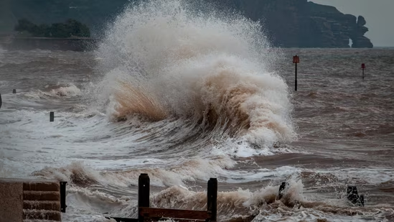


logo
TSUNAMI
TSUNAMI WARNING
[LOCATION]
MOVE inland or to higher ground NOW
Follow instructions from local officials; Sign up for Alerts: [website]
National Weather Service updates: www.weather.gov
TSUNAMI
ALERTA DE TSUNAMI
[UBICACIÓN]
MUÉVASE tierra adentro o a terrenos mas altos AHORA
Siga las instrucciones de las autoridades locales
Suscribirse a Alertas: [website]
Servicio Meteorológico Nacional: www.weather.gov/ewx/espanol

